Slide 1



Generalized preconditioning for surface chemistry and systems of coupled reactors
Anthony S. Walker,
Raymond L. Speth, Kyle E. Niemeyer
Oregon State University & MIT
This material is based upon work supported by the National Science Foundation under Grant Nos. 1931592 (OSU) and 1931391 (MIT). In addition, we acknowledge travel support from the NSF through USC.
Notes:
Hello and thank you for attending my talk.
My name is Anthony Walker and I am a PhD student at Oregon State University.
I am advised by Kyle Niemeyer and today I will be presenting my extensions to generalized preconditioning including surface chemistry and networks of reactors.
“Generalized preconditioning for surface chemistry and systems of coupled reactors.”
I would like to acknowledge the grants which support this work as well as the NSF grant that supported my travel here today.

Slide 2
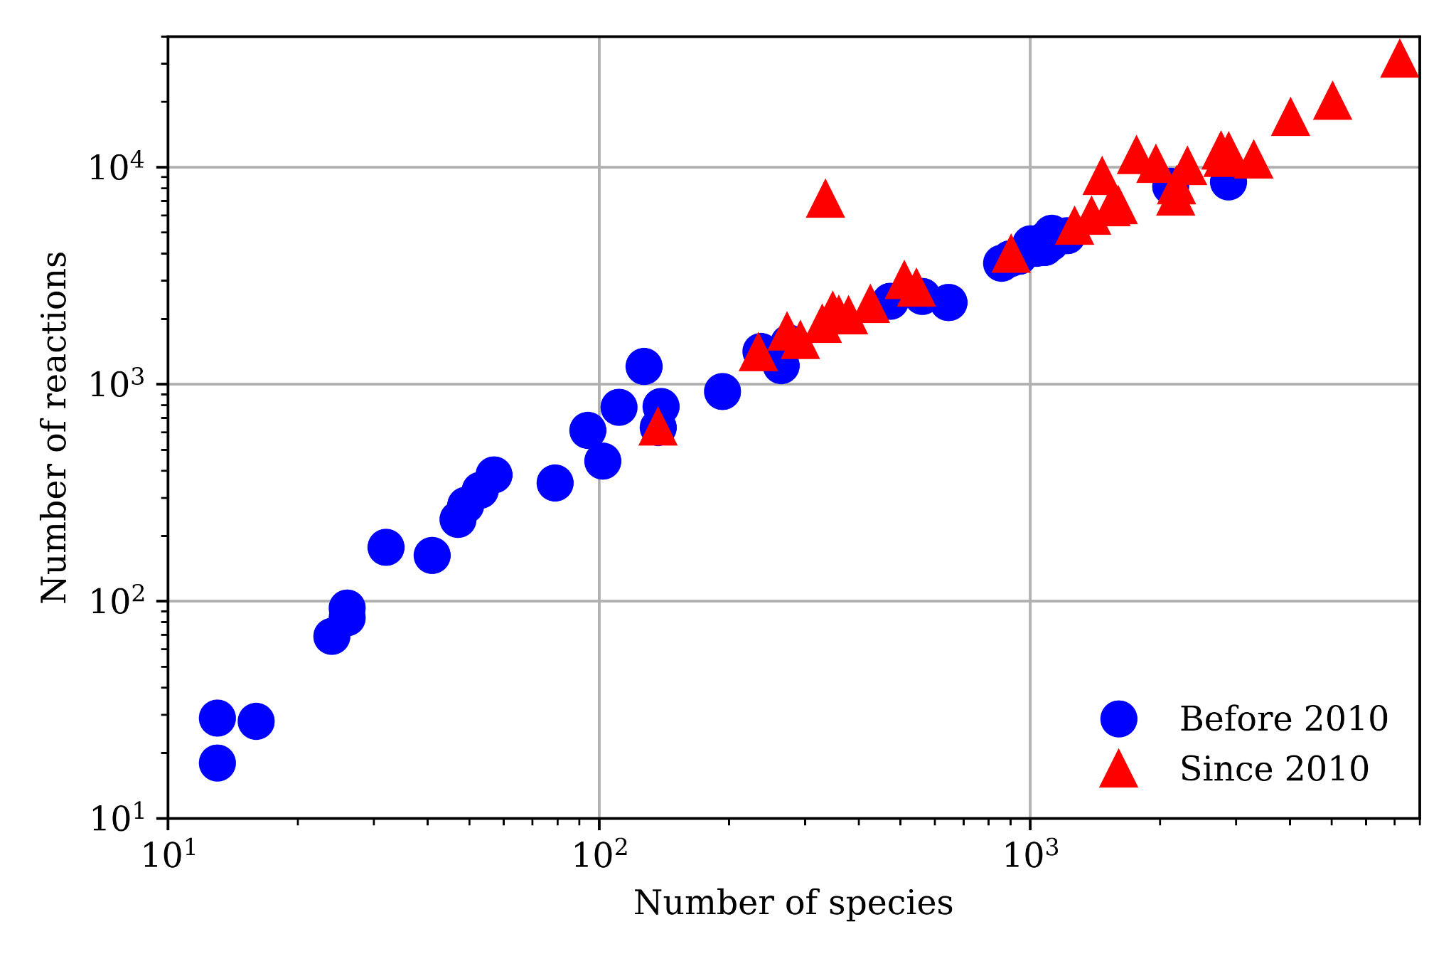
Motivation
Notes:
As we all know, modeling chemical kinetics is expensive.
It is only getting more expensive as you can see from this survey of models. The majority of relevant models have at least 100 species and 1000 reactions.
As we strive to improve the modeling of physical phenomena or model more complex phenomena, the models increase in both the number of species and reactions.
In the case of this work, we are considering multiple models with the inclusion of surface chemistry into simulations—so a gas phase and surface phase model
Ideally, we want to be capable of simulating these larger more complicated models but direct solutions can be prohibitively expensive.
So, we are continuously looking for ways to reduce the expense and accelerate these simulations

Slide 3
Related Work
Reduce model size
Generalized Preconditioning:
Preconditioning
Semi-analytical mole based Jacobian
Adaptive
Sparse linear algebra
Reduce model stiffness
Improving numerics
Anthony S. Walker, Raymond L. Speth, Kyle E. Niemeyer, Generalized preconditioning for accelerating simulations with large kinetic models, Proceedings of the Combustion Institute, 2022, ISSN 1540-7489, https://doi.org/10.1016/j.proci.2022.07.256.
M.J. McNenly, R.A. Whitesides, and D.L. Flowers, Faster solvers for large kinetic mechanisms using adaptive preconditioners. Proceedings of the Combustion Institute, 35(1) (2015) 581-587. https://doi.org/10.1016/j.proci.2014.05.113
Notes:
There are several ways in which we approach reducing the expense of these models
Such as reducing model size which generally involves skeletal reduction, lumping, or hybrid chemistry.
We also attempt to reduce stiffness by removing the timescales which cause the system to be stiff.
Finally, we seek to improve the integration by leveraging different numerical techniques such as varying degrees of analytical jacobians, preconditioning, different factorizations, etc.
Here we build directly on our previous work generalized preconditioning which we applied to zero dimensional gas phase reactors.
This work stemmed from McNenly et al. who developed a method referred to as adaptive preconditioning.
We will go into the details of the preconditioner but on a higher level preconditioning is like making an educated guess before solving a system.
We do this with the use of semi-analytical jacobians that we are using in a sense as our guess.
The adaptive part refers to the systematic removal of terms based on their magnitude so at each stage in which the preconditioner is formed it is adapted by a threshold.
We refer to our approach as generalized as the choice of state vector is moles which improves system sparsity over a traditional mass fraction approach.
This allows us to more effectively leverage sparse linear solvers.

Slide 4
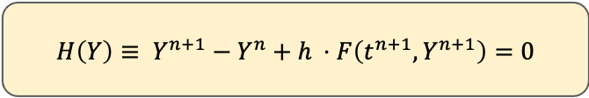
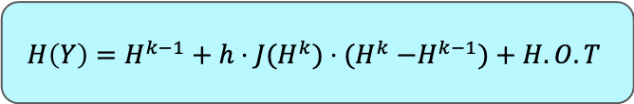
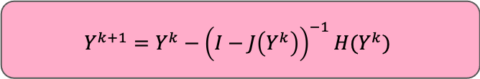
Overall Approach
Implicit Methods
Direct solutions
PGMRES
Iterative solutions
Notes:
This preconditioning is applied to implicit methods.
Typically, we use implicit methods because of the stiffness associated with integrating chemical kinetics.
Among these methods, backwards differentiation is a common method in software like CVODES.
A trivial example would be something like backward euler (yellow box) applied to a nonlinear system where we need to linearize the system.
We linearize it with newton iterations (blue box) which requires the solution to a linear system such as the one shown in the red box.
Direct dense solutions of the linear system are often expensive so we apply iterative methods like GMRES to accelerate this.
We can further accelerate solutions of this step with preconditioning at the expense of forming a preconditioner ahead of time.
This is effectively where we are applying our work.

Slide 5

Open-source library: https://cantera.org
property calculator
canonical simulations
property evaluation/solver for in-house code
Wide range of applications
Combustion
Electrochemistry
Surface chemistry
Non-ideal equations of state
Notes:
This work was implemented within Cantera which, if you are unfamiliar, is an open-source library for thermodynamics, chemical kinetics, and transport, hosted on GitHub and released under a permissive license.
It can be used in various different ways. For example, it offers canonical simulations such 0D reactors, 1D flames/flows, it can also be used as a property calculator or for property evaluation for in-house codes.
It also offers a wide range of applications such as combustion, electrochemistry, surface chemistry, and non-ideal equations of state
Being that this work is inside of a larger chemical kinetics package with extensive existing functionality, it more easily extensible in the future.
We currently have implemented generalized preconditioning for reactors and surface chemistry and it can be used very simply. There is an open Pull Request to merge this work in at present.

Slide 6
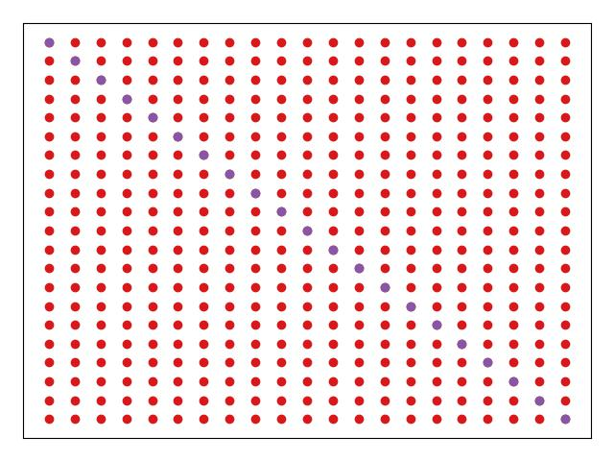
Method Overview
Mass fractions
Notes:
Before, I discuss our method, I want to explain the box on the right.
Consider each box to be a preconditioner with varying levels of assumptions and each dot represents some non-zero element.
The colors will correspond to various parts of the system for example the purple dots here represent the main diagonal terms and the red dots are the rest of the gas phase system

Slide 7
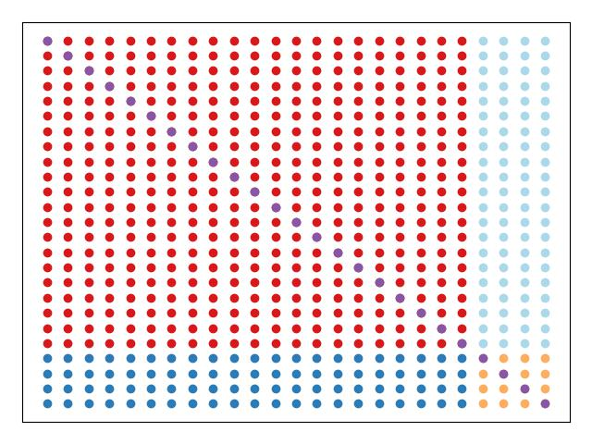
Method Overview
Mass fractions
Surface chemistry
Notes:
When we add surface chemistry to the system we get these additional portions of the preconditioner that must be accounted for.
The yellow dots are derivatives of species contributions with respect to other surface species.
Now that it is a multiphase system there are cross phase derivatives shown in dark and light blue.
As we add, more complexity such as additional phases, we get increasingly larger systems so speed-ups become more imperative.

Slide 8
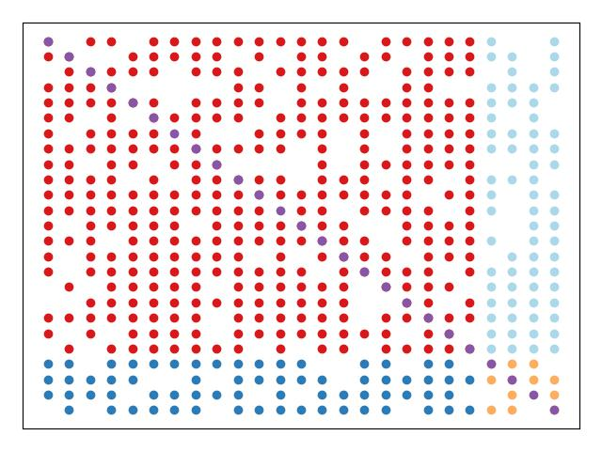
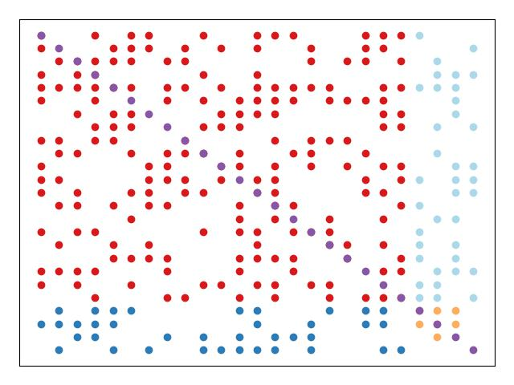
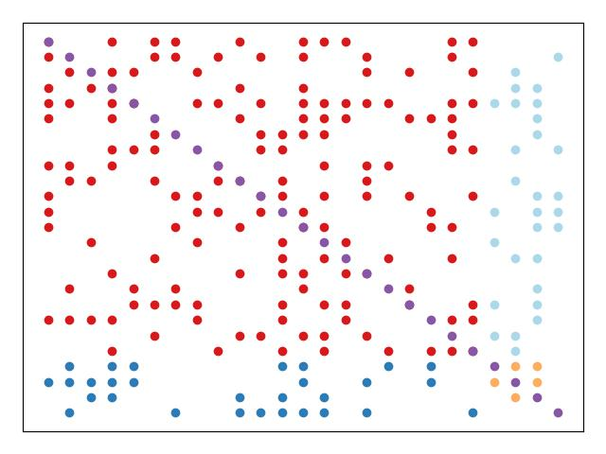
Method Overview
Mass fractions
Surface chemistry
Applying reductions
Notes:
We can then start applying our reductions to the systems
For the gas phase, we neglect pressure-dependent and thirdbody reactions which improves sparsity.
In the case of the surface phase, we are neglecting coverage dependent rates in the derivatives which makes the formulation much simpler while maintaining enough accuracy for good convergence.

Slide 9
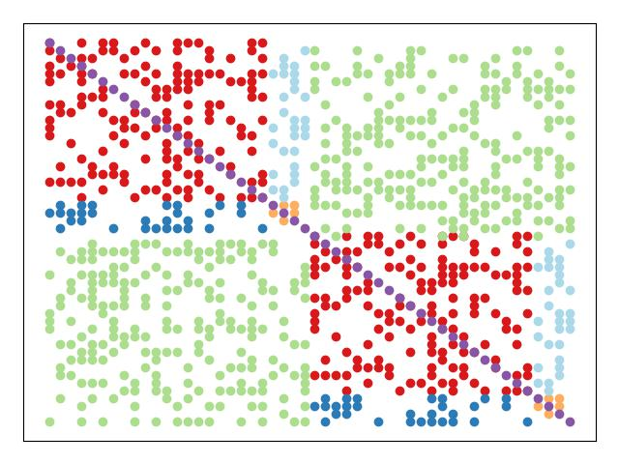
Method Overview
Mass fractions
Surface Chemistry
Applying Reductions
Networks
Notes:
We can finally take this system and couple it with other involved reacting systems.
In Cantera this is a construct known as “Networks” and through this coupling, we effectively double the number of variables.
For example, coupling two systems with something like mass flow between the two would result in a Jacobian like the one depicted.
We pick-up inter-reactor dependence terms shown in green. For our simulations, we are using a constant inlet mass flow rate and pressure dependent outlet flow rate.
It turns out that we can generally neglect these terms in these cases.

Slide 10
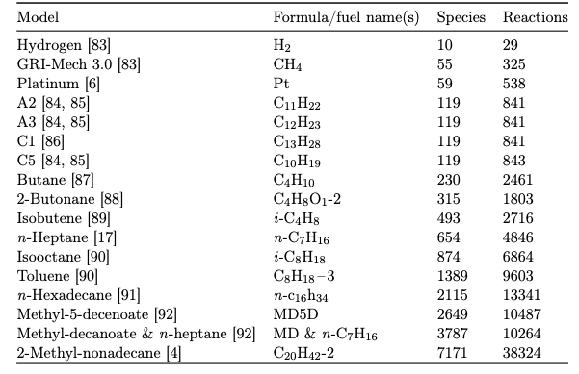
Testing
17 Models
0 to 10⁻¹⁸
PFR with Surface
System of Reactors
Notes:
We tested our implementation with combinations of different models that you can see in this table with a range of species between 10 and approximately 7200
The range of reactions is from 30 to approximately 38000.
In these tests we applied a range thresholds or again the value that prunes elements this range was from 0 or no thresholding to 1e-18 in multiples of 1/10th.
All of these models and thresholds were setup in two systems, a plug-flow reactor with a platinum surface and a pseudo combustor-exhaust system

Slide 11
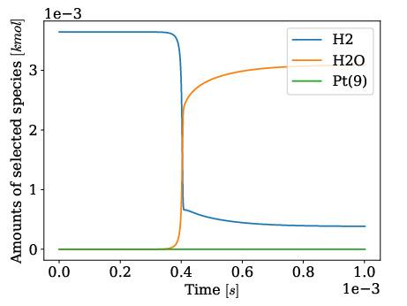
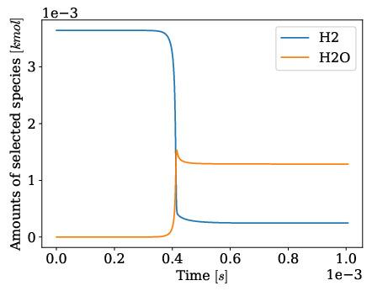
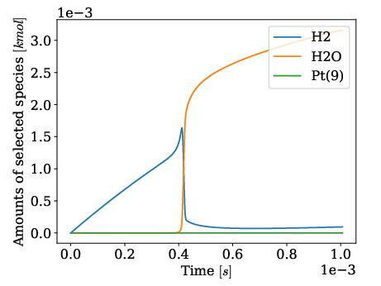
Test Setup
Notes:
Each system and model combination was well constrained with initial conditions to experience some ignition event around 4e-4 seconds and integrated to 1e-3 seconds.
The behavior varies slightly for each model but follows the constraints we have set forth.
The plug-flow reactor behavior for Hydrogen looks like this.
The network of a combustor and exhaust reactor looks like this.
Note that Platinum is non-zero but the concentration of surface species is very small in comparison too gas phase species.

Slide 12
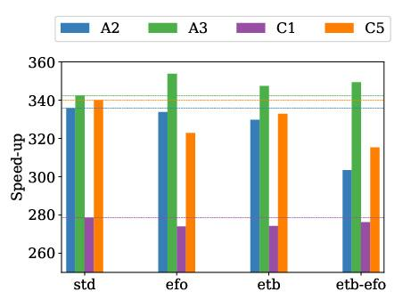
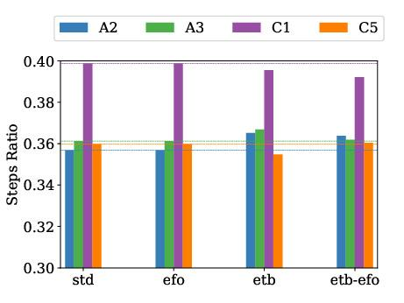
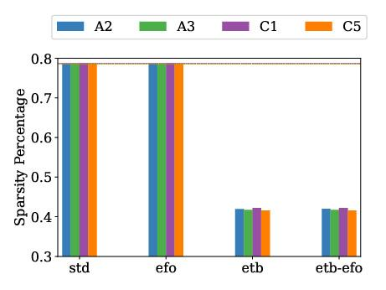
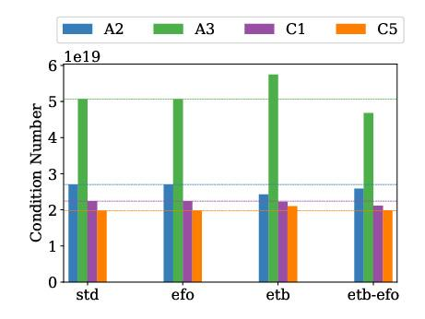
Assumption Analysis
Notes:
Our first analysis was a subset of similar models with similar numbers of species and reactions, approximately 120 species and 840 reactions.
We have four cases for each model, that is the standard case with normal assumptions applied, efo stands for enable falloff reactions, etb stands for enable third body
We determined from this analysis that performance is really driven by the number of steps one solver is taking vs. another.
Using sparse systems was an important conclusion of previous work and while sparsity plays a role it is not the sole driving force and becomes less important when problems exhibit particularly stiff behavior.
We can see this as A3 performs better in every case when less assumptions are made.
We look at condition number of the preconditioner and see that the preconditioner is much more ill-conditioned for A3 and this inversely correlates with the speedup.
So ultimately, developing the optimal solver is a balance of sparsity and jacobian exactness. Particularly stiff systems will perform better with less assumptions applied.

Slide 13
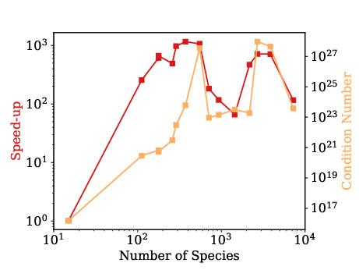
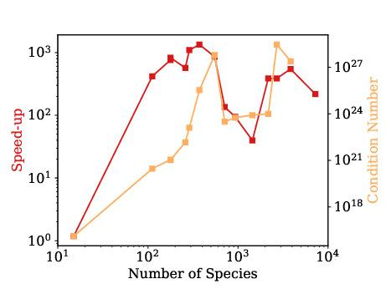
Performance
Plug-flow reactor performance
Combustor-exhaust reactor performance
Notes:
We dive further into understanding the behavior of the method by considering a larger set of models including surfaces now.
The speed-up of each model is plotted with the condition number of the system against the number of species and contrary to former studies we do not see the same general increase in performance with the number of variables.
For each plot, we see improvements above 100 species in a range of 0.94 to 1340 and we see the rises and falls in condition number correlate well with the speed-up.
We also see that the effectively doubling the size of the system does not necessarily change performance with
the tightly constrained problem.
The plot on the right has nearly double the number of variables as the left but performance behavior is identical.

Slide 14
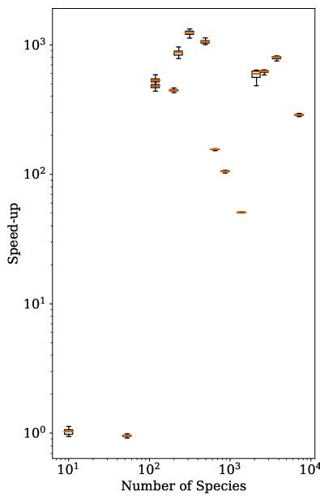
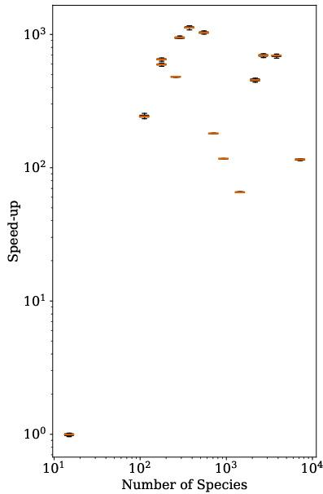
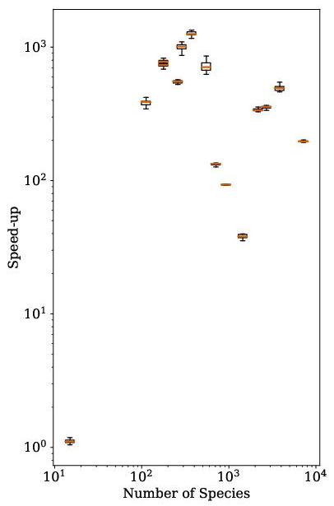
Thresholding Analysis
Plug-flow reactor
Plug-flow reactor & Surface
Combustor & Surface
Notes:
Our next analysis was of the thresholding impact.
Here we have 3 cases, a PFR without a surface, a PFR surface, and the combustor exhaust system with a surface.
Here we see that each case exhibits very similar performance behavior despite system size. A major difference is the GRI model in the PFR with and without a surface because adding the surface models pushs the number of species over the 100 species mark.
We however seem very little variation in performance with thresholding and it is equally likely to diminish performance.
Variation is generally an order of magnitude less than the speed-up itself.

Slide 15
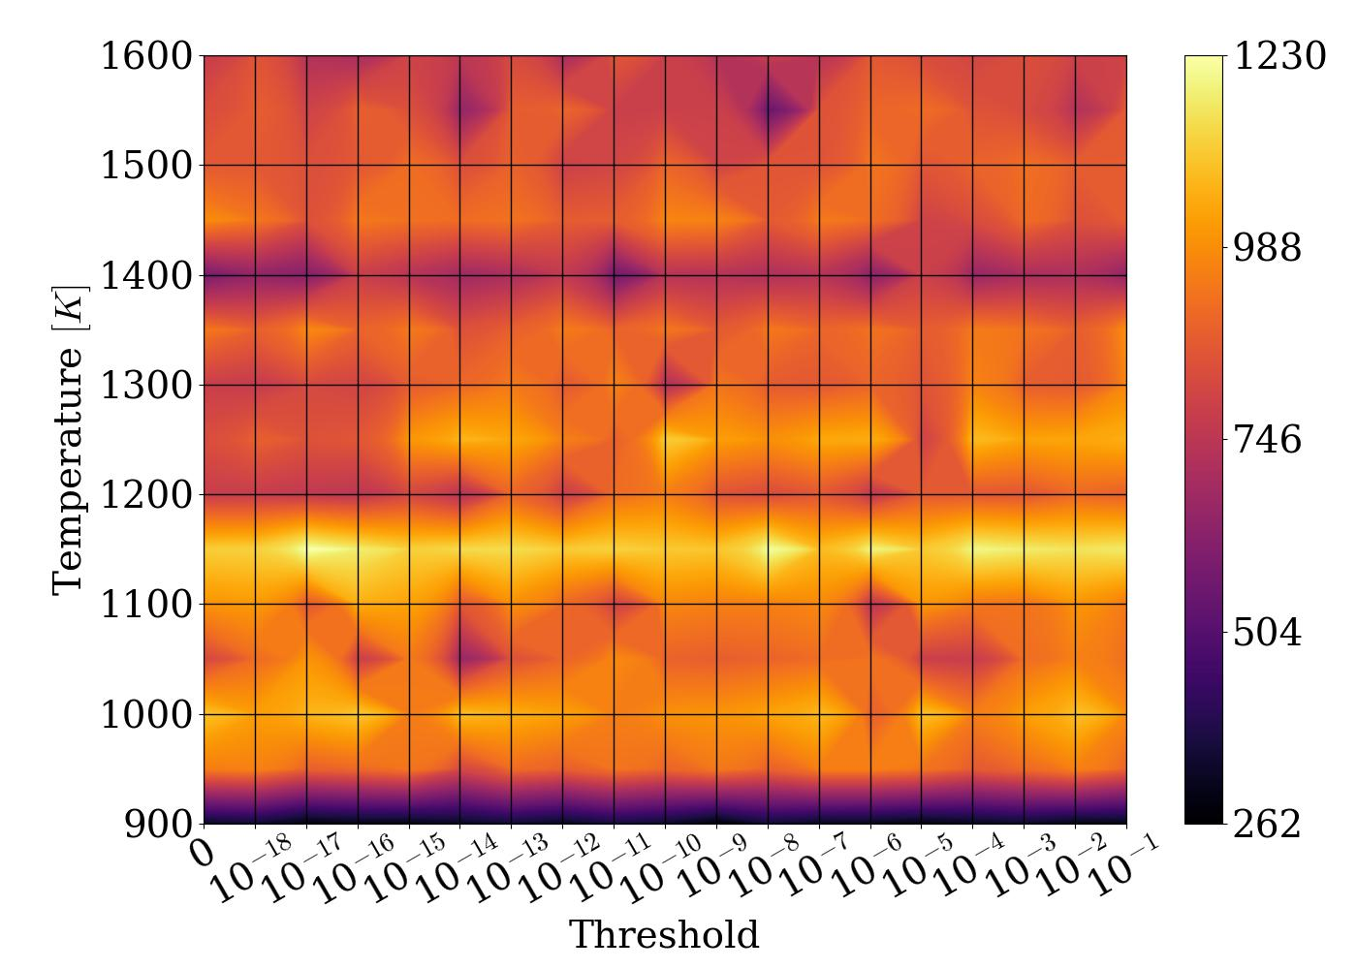
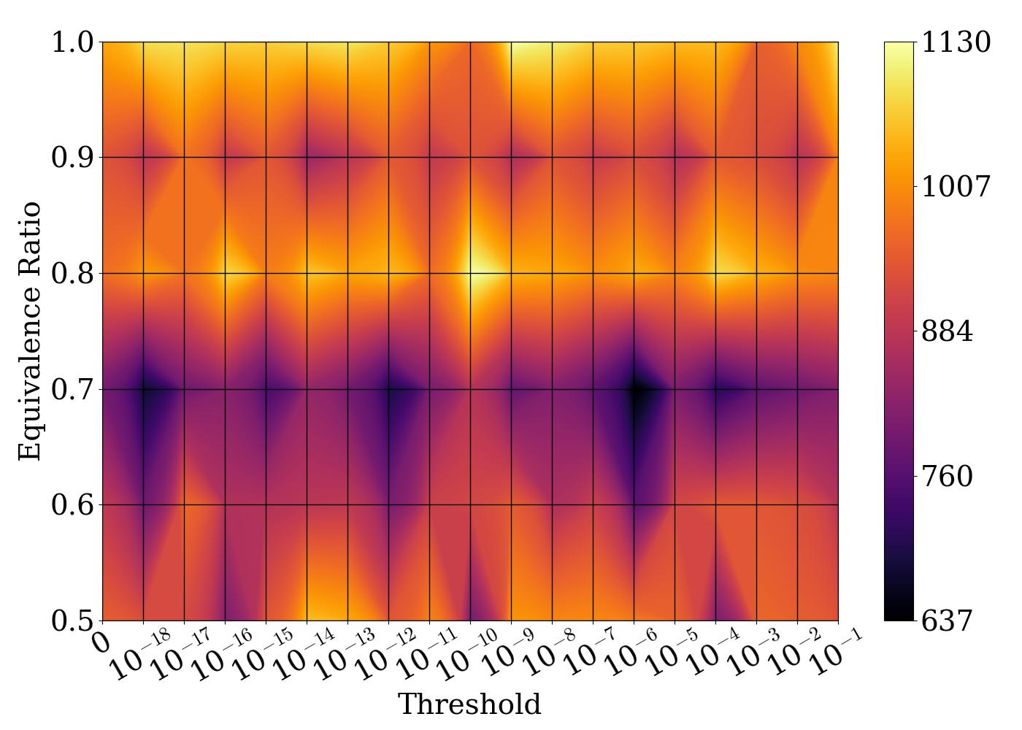
Thresholding Analysis
Speed-up (T, th), ɸ = 0.9
Speed-up (ɸ, th), T = 1350K
Notes:
We further investigated the performance of thresholding with a parametric study of the Butane model.
We see on the left speed-up as a function of temperature and threshold with a fixed equivalence ratio.
We generally see a horizontally banded behavior implying very little change in performance based on threshold for a given set of initial conditions.
In the case of varying equivalence ratio, we see slightly more variation.
However, in both cases, performance variation is minor and may be negative.
That aside, we have not found a means of determining an optimal threshold a priori. There is some correlation with condition number but we are again balancing Jacobian exactness and sparsity.
Ultimately, there is little practical use of thresholding with minimal variation and no simple means of determining it a priori.

Slide 16
Summary, Conclusions, Future Direction
Extended generalized preconditioning to surface chemistry and systems of reactors, speed-up was obtained in the range of 0.94 to 1342
Performance is driven by improvements over the number of steps taken by the traditional solver and number of variables isn’t necessarily the driving factor with tightly constrained problems.
Threshold does not have a major or consistent impact on performance and we obtain substantial speedup without thresholding.
Plan to extend to additional phases of matter and applications which require large speed-ups to be tractable.
Notes:
Extended generalized preconditioning to surface chemistry and systems of reactors, speed-up was obtained in the range of 0.94 to 1342
Performance is driven by improvements over the number of steps taken by the traditional solver and number of variables isn’t necessarily the driving factor with tightly constrained problems.
Removal of particular contributions to obtain greater sparsity isn’t always beneficial and more ill-conditioned systems may perform better with those contributions
Threshold does not have a major or consistent impact on performance and we obtain substantial speedup without thresholding.
Plan to extend to additional phases of matter and applications which require large speed-ups to be tractable.

Slide 17
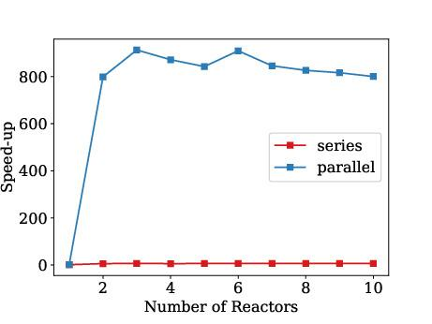
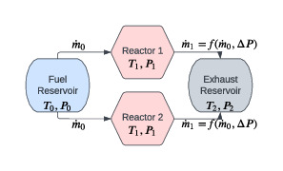
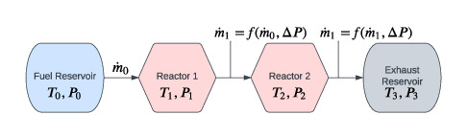
Network Comparison
Notes:
We investigated this with plug-flow reactors in a series and parallel configuration using the GRI mechanism.
We have these two configurations setup on the right.
In series, ignition events become less substantial in downstream reactors.
In parallel, all reactors experience the same ignition event. We see that for each reactor addition beyond 2 reactors, which achieves the 100 species mark, does not substantially impact performance after that for the parallel setup.
The series setup actually never achieves a huge performance increase which implies that performance is less dependent on the number of variables and more dependent on the problem itself.

